Slide 1
Image TransforMs
By
Dr. Ratnakar Dash
CSE Dept. NIT Rourkela

Slide 2
Image Transforms
Image transforms can be simple arithmetic or complex mathematical operations on images which convert images from one representation to another.
Image (NxN)
{X_{N}}
Transform
Image (NxN)
{Y_{N}}
Y=AX
Image (NxN)
{Y_{N}}
Inverse
Transform
Image (NxN)
{X_{N}}
X=A⁻¹Y

Slide 3
Applications
Preprocessing
Filtering
Enhancement
Image Compression
Feature Extraction
Edge detection
Corner detection

Slide 4
Unitary Matrix
Image transformation represents a given image into series sum of unitary matrices
A matrix is called unitary if
Unitary Matrices are basis images

Slide 5
Properties of Unitary Transform y =Ax
Energy Conservation
|| y ||² = || x ||²
|| y ||² = || Ax ||²= (Ax)^{*T} (Ax)= x^{*T} A^{*T} A x = x^{*T} x = || x ||²
Rotation
A unitary transformation is a rotation of a vector in an N-dimension space, i.e., a rotation of basis coordinates
Notes:
Determinant and all eigenvalues have unit magnitude

Slide 6
Contd..
Energy Compaction
Many common unitary transforms (like DCT, KLT etc.) tend to pack a large fraction of signal energy into just a few transform coefficients
Decorrelation
Highly correlated input elements ➔ quite uncorrelated output coefficients
Covariance matrix E[( y – E(y) ) ( y – E(y) )^{*T} ]

Slide 7
What is orthogonal ?
A set of real valued continuous functions
{a_{n}(t)} = {a_{o}(t), a₁(t),…} is said to be orthogonal over
(t₀, t₀+T) if

Slide 8
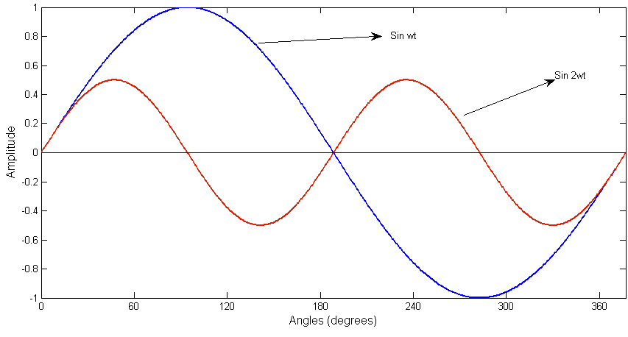
Example
{sinωt, sin2ωt}

Slide 9
Orthogonal Expansion
Any arbitrary signal x(t); {t₀, t₀+T}
Can be represented by series summation of a set of orthogonal basis functions.
nth coefficient of expansion

Slide 10
Contd..
Orthonormal Set

Slide 11
Complete, Closed(orthogonal functions)
There is no signal x(t) with
such that
x(t) with
Such that

Slide 12
Discrete Formulation
Let the set of samples represented by {u(n): 0 ≤ n ≤ N-1} is a vector of dimension N
Premultiply u by a unitary matrix A of dimension N*N, we get another vector
v= Au
Transformed vector
Transformation matrix

Slide 13
Contd..
In the form of series summation
where
As A is a unitary matrix we can get back as
The columns of
i.e.,
are called the basis vectors of A

Slide 14
Example
Let
basis vectors b₁ b₂ b₃

Slide 15
Contd..
In case of an image, an image can be represented by a set of basis images
Image
N × N matrix/ N² numbers of such matrices
Inverse Transform

Slide 16
Contd..
Set of complete orthonormal discrete basis function satisfies the
following properties
Orthonormality
Completeness

Slide 17
Computational Complexity
To Compute transform coefficient
For each no. of complex multiplications and additions
~ O(N²), so for all ~O(N⁴) which is quite expensive for practical size Images.
How to reduce computation time??
Using separable unitary transforms

Slide 18
Separable Transforms
where are 1D orthonormal sets of basis vectors
should be unitary matrices themselves
In most cases we choose A & B to be same.
These are called 2D separable transformation
The 2D transform can be performed first by transforming each column of U and then transforming each row of the result to obtain rows of V complexity is 2N³

Slide 19
Concept of Basis Images
Let denotes the k^{th} column of
Define the matrices
Define the inner product of two NxN matrices F and G

Slide 20
Concept of Basis Images
Then the transformation equation can be written as
U is represented by linear combination of N² Matrices.
These matrices are called basis images

Slide 21
Example
To get basis images, take outer product of the columns of

Slide 22
Contd..
Inverse Transform gives

Slide 23
Some Transformation Techniques
Discrete Fourier Transform
Discrete Cosine Transform
Karhunen-Loeve Transform
Haar Transform
Walsh Transform
Hadamard Transform

Slide 24
Fourier Transform (1D)
Continuous Fourier Transform (CFT)
Frequency, [Hz]
Phase
Spectrum
Amplitude
Spectrum
Inverse Fourier Transform (IFT)

Slide 25
Discrete Fourier Transform (1D)
Discrete Domains
Discrete Time: n = 0, 1, 2, 3, …………, N-1
Discrete Frequency: k = 0, 1, 2, 3, …………, N-1
Discrete Fourier Transform
Inverse DFT
Equal time intervals
Equal frequency intervals
K = 0, 1, 2,….., N-1
n = 0, 1, 2,….., N-1

Slide 26
2D – Discrete Fourier Transform
Image: f(x, y), 0≤x≤N-1, 0≤y≤N-1
Transform kernel:
Discrete Fourier Transform of f(x, y)is

Slide 27
Contd..
In general, Transform kernel can be represented as:
Discrete Fourier Transform of f(x, y) can be represented as

Slide 28
Contd..
Let R(u,v), I(u,v) be real part and imaginary part of F(u,v)
Modulus：
Phase：
Power Spectrum：

Slide 29
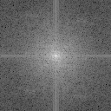
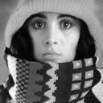
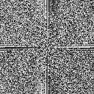
Amplitude and Phase
amplitude
phase
original

Slide 30

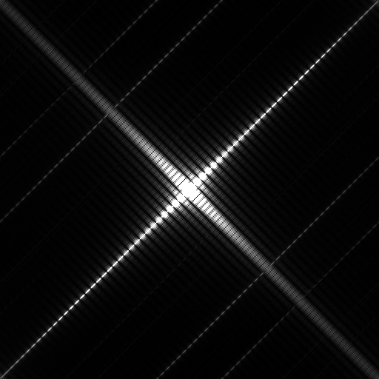
Images and their spectrums
Image domain
Frequency domain
Image domain
Frequency domain

Slide 31
Properties of 2-D Fourier Transform
Separability
Linearity
Scaling
Shift Theorem
Rotation
Periodicity and conjugation
Convolution
Correlation
Average

Slide 32
Separability
The implementation steps for the two-dimensional DFT may be visualized as shown in the diagram below
f(x,y)
Column
Transforms
F(x,v)
Row
Transforms
F(u,v)
Multiply by N

Slide 33

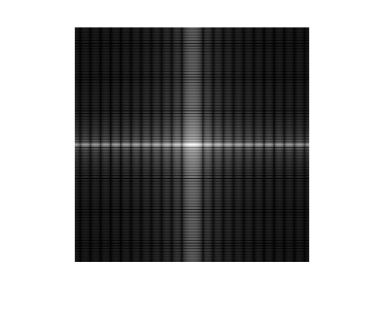
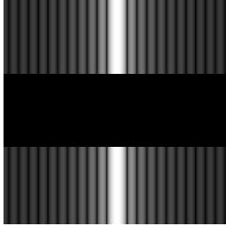
Separability (contd. )
f(x,y)
F(u,v)
f(x,y)
F(x,v)
F(u,v)

Slide 34
Linearity
DFT is a linear operator
F[ a f₁(x,y)+b f₂(x,y)] = aF₁(u,v)+bF₂(u,v)

Slide 35


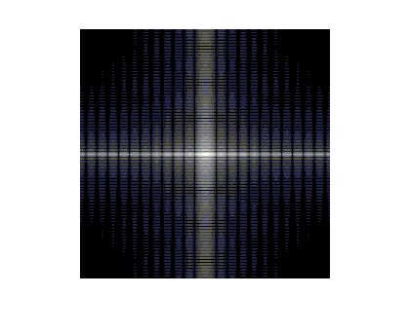
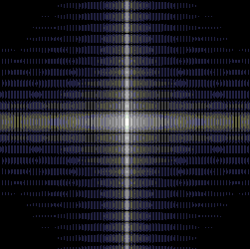
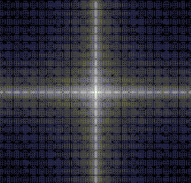
Linearity (contd..)
f₁(x,y)
f₂(x,y)
2f₁(x,y)+3f₂(x,y)
F₁(u,v)
F₂(u,v)
Phase Spectrum (2F₁(u,v)+3F₂(u,v))

Slide 36
Scaling

Slide 37

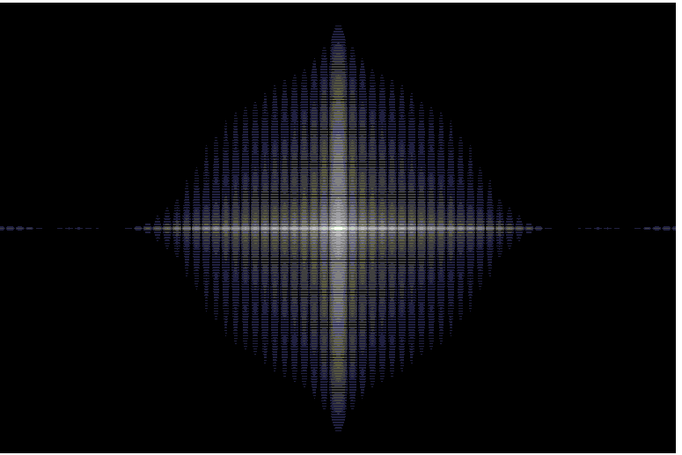
Scaling (contd..)
f(x,y)
F(u,v)
f(2x,3y)
F(u,v)

Slide 38
Shift Theorem

Slide 39
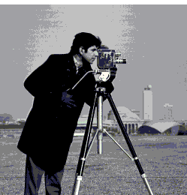
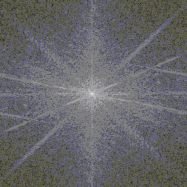
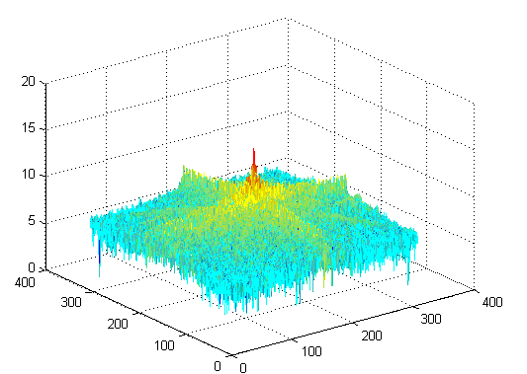
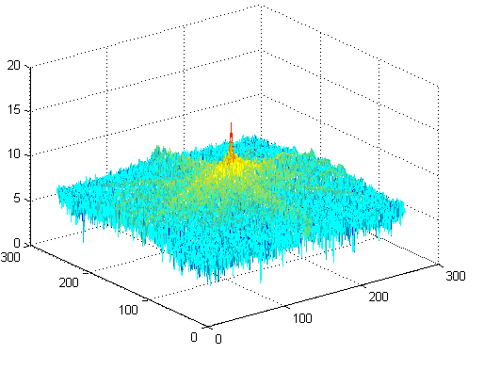
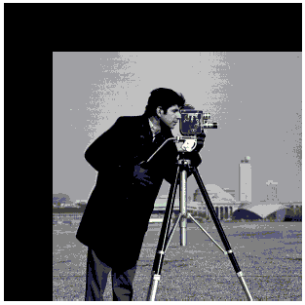
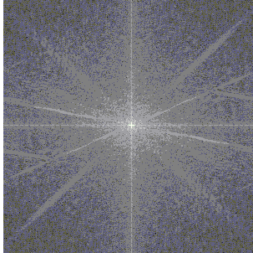
Shift Theorem (contd..)
Original Image
Spectrum Image
Mesh Plot
T_{x} = 50, T_{y} =50
Spectrum Image
Mesh Plot

Slide 40

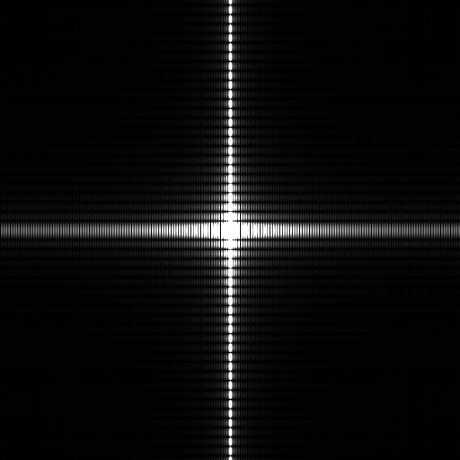
Rotation
In polar coordinates, f (x,y) and F(u,v) can be represented by f(r, θ) and F(w,φ) alternatively. Then
f (r, θ+ θ₀) F(w,φ + θ₀)
(a) a sample image
(b) its spectrum
(c) rotated image
(d) resulting spectrum

Slide 41
Periodicity and conjugation
Periodicity ：
F(u,v) = F(u+aN,v+bN)
f (x,y) = f (x+aN,y+bN)
Where a, b = 0, ±1, ± 2,……
Conjugation：
F(u,v) = F*(-u,-v)
|F(u,v)| = |F(-u,-v)|

Slide 42
Convolution
2-D convolution is defined as:
Then: f(x, y)*g(x, y)⬄ F(u, v)G(u, v)
f(x, y)g(x, y)⬄F(u, v)*G(u, v)

Slide 43
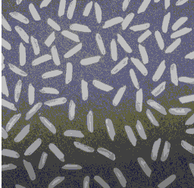
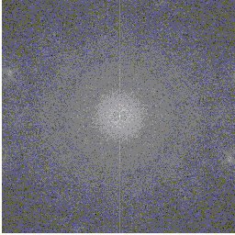
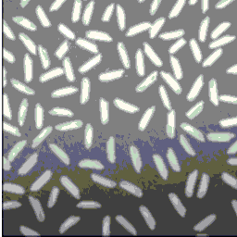
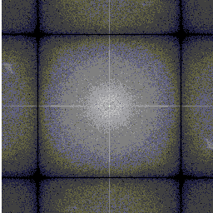
Convolution (contd..)
Original image
Spectrum
Convolved image(convolved with mean filter)
Spectrum

Slide 44
Correlation
2-D correlation is defined as：
Correlation Theorems：

Slide 45
Average
Average of 2D image f (x, y) is defined as：
Let u=v=0 , then:

Slide 46
Contd..
<
<
image
and its spectrum

Slide 47
Fast Fourier Transform
recursive algorithm
decimation in time = odd even in freq. domain
decimation in freq. domain = odd even in time

Slide 48
Visualizing the DFT
Consider the power spectrum of the 1D square wave

Slide 49
Visualizing the DFT(circular shifting)
The FT is centered about the origin
But the DFT is centered about N/2
We need to correct with a circular shift operation
Or, multiply by (-1) prior to taking the transform
k

Slide 50
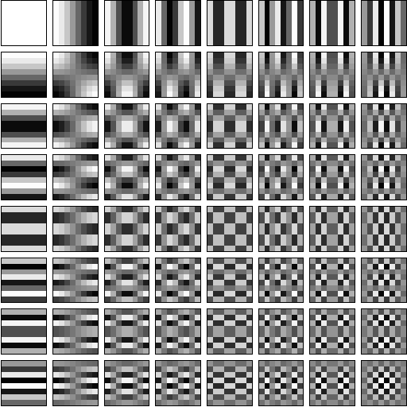
DFT basis images

Slide 51
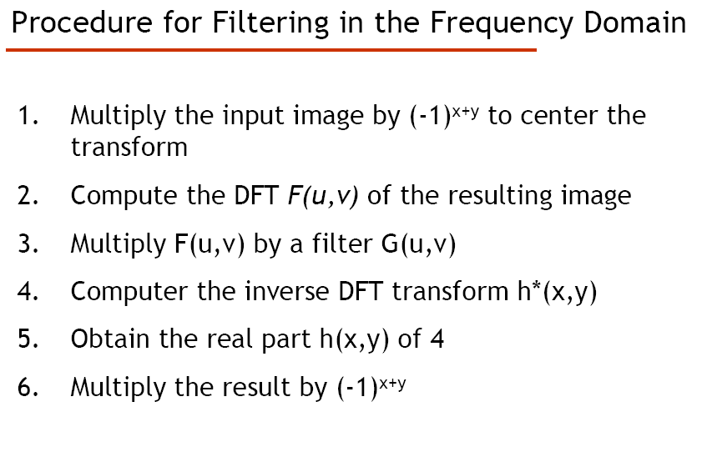

Slide 52
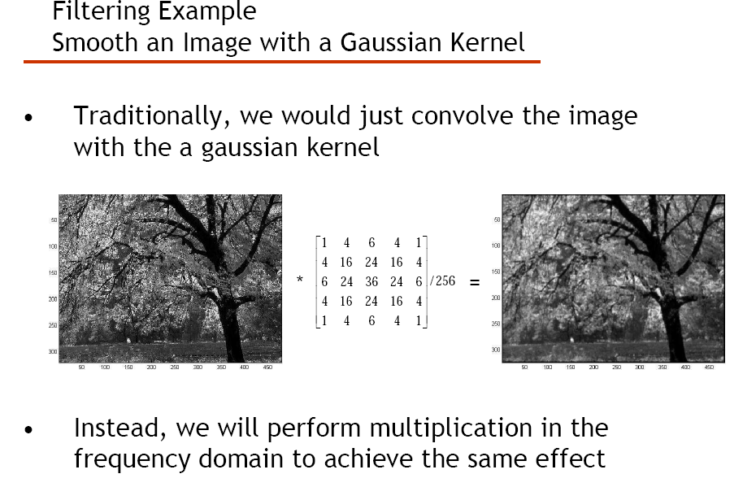

Slide 53
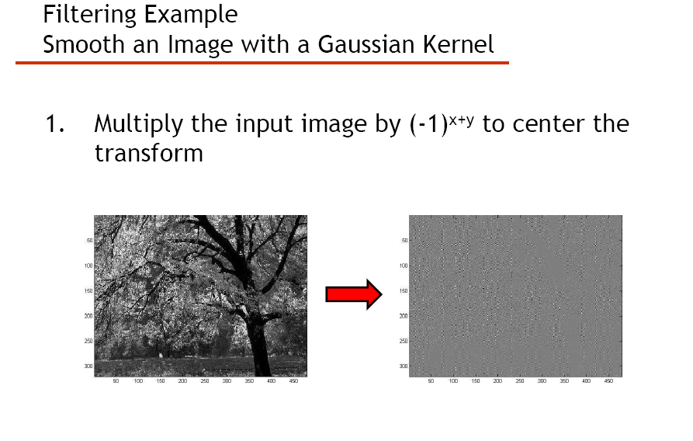

Slide 54
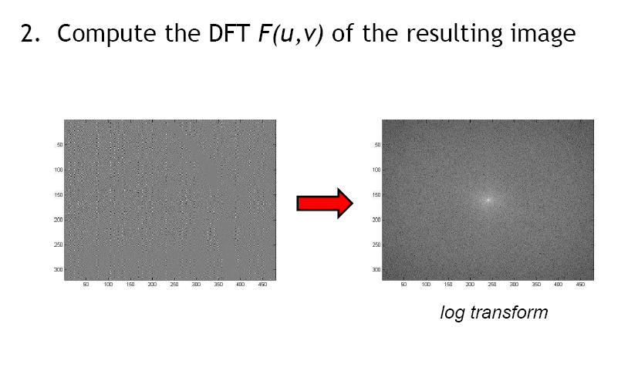

Slide 55
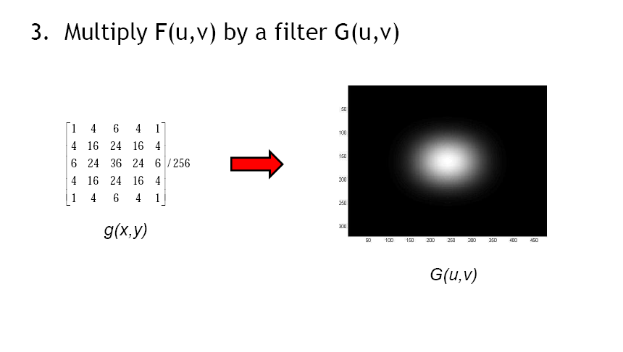

Slide 56
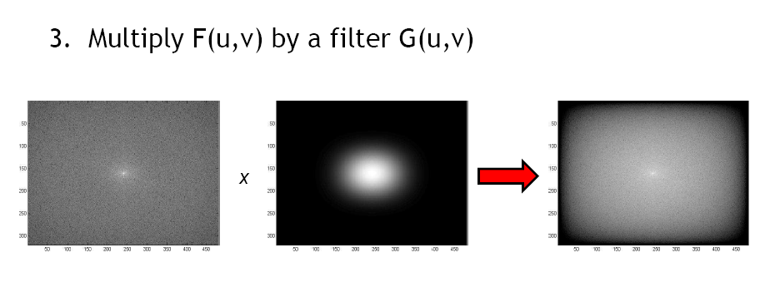

Slide 57
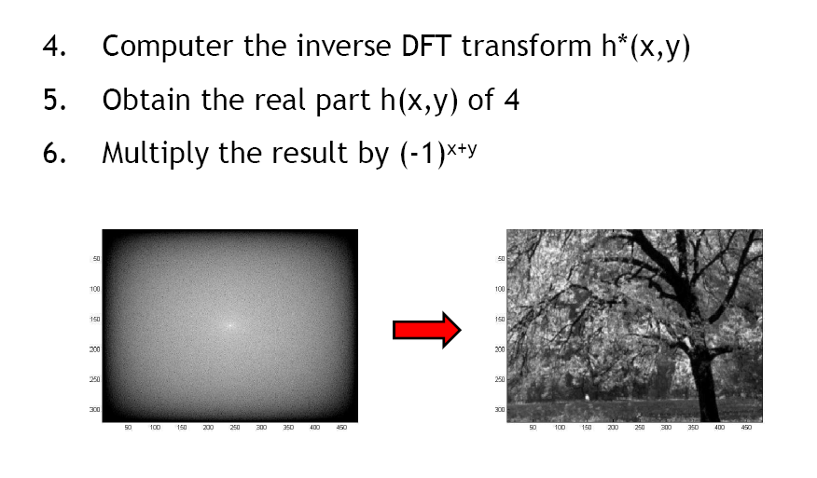

Slide 58
Example
img=imread('lena.bmp','bmp');
subplot(121);imshow(img);
title('original image ')
fimg=fftshift(fft2(img));
subplot(122); imshow(abs(fimg)/10000)
title(' transformed image ')

Slide 59
Discrete Cosine Transform (DCT)
DCT expresses a sequence of finite data points in terms of a sum of cosine functions oscillating at different frequencies.
These cosine functions are treated as its basis function.
Fast algorithm exists.
Most popular in image compression application because of its energy compaction property.
Adopted in JPEG.
The periodicity implied by DCT implies that it causes less blocking effect than DFT.
Can be implemented by 2n points FFT.

Slide 60
Contd..
Transform kernel of two-dimensional DCT is
where
Clearly, the kernel for the DCT is both separable and symmetric, and hence the DCT may be implemented as a series of one dimensional DCTs.

Slide 61
Contd..
Forward transform
Inverse Transform
where u, v, x, y = 0, 1, 2, …, N-1
Forward and inverse transformations are same

Slide 62
clc;
clear
N=8
x=(0:N-1)';
C=cos((2*x+1)*x'*pi/(2*N))*sqrt(2/N);
C(:,1)=C(:,1)/sqrt(2);

Slide 63
Kernel matrix to generate DCT Basis Images
0.353553 | 0.490393 | 0.46194 | 0.415735 | 0.353553 | 0.277785 | 0.191342 | 0.097545
0.353553 | 0.415735 | 0.191342 | -0.09755 | -0.35355 | -0.49039 | -0.46194 | -0.27779
0.353553 | 0.277785 | -0.19134 | -0.49039 | -0.35355 | 0.097545 | 0.46194 | 0.415735
0.353553 | 0.097545 | -0.46194 | -0.27779 | 0.353553 | 0.415735 | -0.19134 | -0.49039
0.353553 | -0.09755 | -0.46194 | 0.277785 | 0.353553 | -0.41573 | -0.19134 | 0.490393
0.353553 | -0.27779 | -0.19134 | 0.490393 | -0.35355 | -0.09755 | 0.46194 | -0.41573
0.353553 | -0.41573 | 0.191342 | 0.097545 | -0.35355 | 0.490393 | -0.46194 | 0.277785
0.353553 | -0.49039 | 0.46194 | -0.41573 | 0.353553 | -0.27779 | 0.191342 | -0.09755

Slide 64
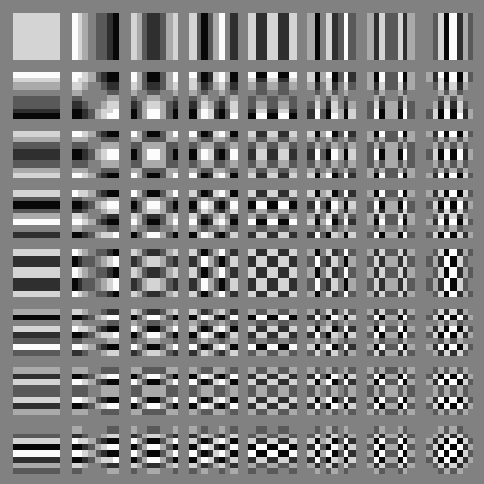
Basis images of an 8x8 DCT

Slide 65
Properties of DCT
Separability
2D DCT/ IDCT expression shows that they are separable. So they can be implemented as two 1-D DCT/IDCT
Fast DCT
FDCT is possible in the same manner as FFT
Periodicity
Magnitude of DCT coefficient is periodic with period 2N

Slide 66

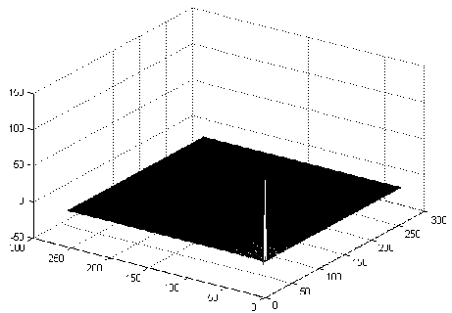
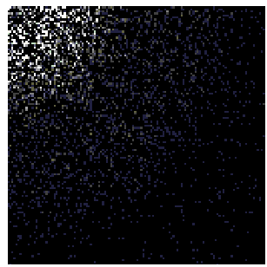
Example
Original Image
DCT Coefficients
DCT Coefficients (Zoomed)
Mesh Plot

Slide 67
Image Reconstruction in DCT
Original image
Reconstructed image
Using only 1 DCT coefficient
Using 3 DCT coefficients
Coefficients are selected out of 8x8 window

Slide 68
Contd..
Using 6 DCT coefficients
Using 15 DCT coefficients
Using 10 DCT coefficients
Using 64 DCT coefficients

Slide 69
Karhunen-Loeve Transform
K-L transform is a linear combination of orthogonal functions of ensembles of input images.
Basis functions are image dependent
No fast algorithm exists
Usually used for comparison
Transform kernel is not fixed unlike other transforms
Based on second order statistical properties of image
Also called Hotelling transform or method of principal components

Slide 70
Contd..
Covariance matrix of a population of vectors
So, Orthogonal vectors of C_{x} can be calculated

Slide 71
Contd..
Calculate eigenvectors and eigen values of C_{x}
Sort eigen vectors depending on decreasing values of
eigen values
Select some of the eigenvectors
These eigenvectors are considered as transformed matrix
Calculate the transformed images
Y is called as principal component coefficients.
This transformation is called K-L transform

Slide 72
Properties of Y

Slide 73
Example
Input matrix
Mean Vector

Slide 74
Contd..
Compute Eigen values

Slide 75
Contd..
We get two Eigen vectors
Transform Matrix

Slide 76
Contd.
Reconstructed
K no of Eigen vectors

Slide 77
Properties of K-L Transform
Decorrelation
E[ y y^{H} ]= E[ (U^{H} x) (U^{H} x)^{H} ]= U^{H} E[ x x^{H} ] U = diag{λ₁, λ₂, … , λ_{N}}
Note: Other matrices (unitary or nonunitary) may also decorrelate the transformed sequence
Minimizing MSE under basis restriction
If only allow to keep m coefficients for any 1≤ m ≤N, what’s the best way to minimize reconstruction error?
Keep the coefficients w.r.t. the eigenvectors of the first m largest Eigen values

Slide 78
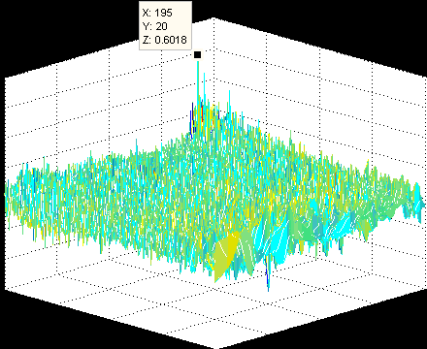
Principal Component Coefficients
Lena image
Energy compaction in lena image

Slide 79
Image Reconstruction in K-L Transform
1 PC
10 PCs
20 PCs
Original image
50 PCs
All PCs

Slide 80
Haar Wavelet Transform
One dimensional transformation on each row followed by one dimensional transformation of each column.
Extracted coefficients would be
Approximation
Vertical
Horizontal
Diagonal
Approximation coefficients are further decomposed into the next level
4 level decomposition is used

Slide 81
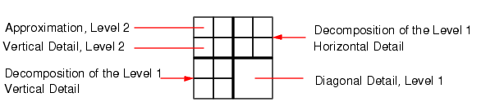
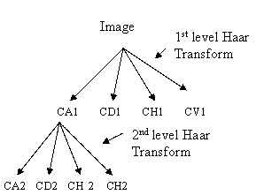
Contd..
Graphical Representation - Wavelet decomposition (level = 2)

Slide 82
Approach
For a 2X2 matrix

Slide 83
Example
2 | 2 | 9 | 5
2 | 0 | 5 | 2
6 | 7 | 4 | 7
3 | 4 | 8 | 8
4 | 14 | 0 | 4
2 | 7 | 2 | 3
13 | 11 | -1 | -3
7 | 16 | -1 | 0
Column wise Summation
Row wise Summation
Approximation
Horizontal
3 | 10.5 | 1 | 3.5
10 | 13.5 | -1 | -1.5
1 | 3.5 | -1 | 0.5
3 | -2.5 | 0 | -1.5
6 | 21 | 2 | 7
20 | 27 | -2 | -3
2 | 7 | -2 | 1
6 | -5 | 0 | -3
Finding Average
Vertical
Diagonal

Slide 84
Properties of Haar transform
The Haar transform is real and orthogonal. Therefore, H_{r}=H_{r}*
The Haar transform is a very fast transform.
On an Nx1 vector it can be implemented in O(N) operations
The Haar transform has poor energy compaction for Images

Slide 85
%Initialization
H=[1]; NC=1/sqrt(2);%normalization constant LP=[1 1]; HP=[1 -1]; % iteration from H=[1]
for i=1:Level H=NC*[kron(H,LP);kron(eye(size(H)),HP)];
end
HaarTransformationMatrix=H;

Slide 86

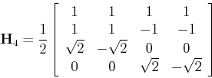

Slide 87
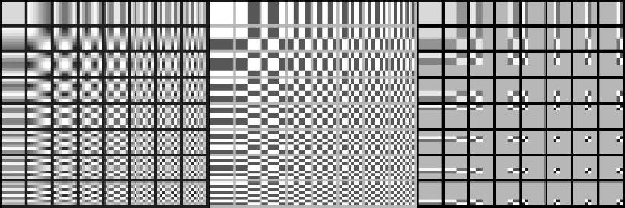
Basis images of Haar Transform

Slide 88
1-step Haar Decomposition
Original image
Haar transformed image

Slide 89
2-step Haar Decomposition

Slide 90
Discrete Walsh Transform (1-D)

Slide 91
Contd..
Difference lies in Multiplicative Factor

Slide 92
Discrete Walsh Transform (2-D)

Slide 93
Contd..

Slide 94
Property
Separable

Slide 95
Basis images of Walsh Transform

Slide 96
Hadamard Transfrom

Slide 97
Hadamard Matrix
u
 | 0(0) | 1(7) | 2(3) | 3(4) | 4(1) | 5(6) | 6(2) | 7(5)
0 | + | + | + | + | + | + | + | +
1 | + | - | + | - | + | - | + | -
2 | + | + | - | - | + | + | - | -
3 | + | - | - | + | + | - | - | +
4 | + | + | + | + | - | - | - | -
5 | + | - | + | - | - | + | - | +
6 | + | + | - | - | - | - | + | +
7 | + | - | - | + | - | + | + | -
sign changes are not
ordered (shown in backet)
x

Slide 98
Hadamard transform
Transform matrices can be recursively generated
Note: Hadamard Coefficients need reordering to concentrate energy

Slide 99
Contd..
N=2

Slide 100
Ordered Hadamard Transformation
b_{i} (u) is changed to p_{i}(u)

Slide 101
Contd..
N = 8
u
 | 0 | 1 | 2 | 3 | 4 | 5 | 6 | 7
0 | + | + | + | + | + | + | + | +
1 | + | + | + | + | - | - | - | -
2 | + | + | - | - | - | - | + | +
3 | + | + | - | - | + | + | - | -
4 | + | - | - | + | + | - | - | +
5 | + | - | - | + | - | + | + | -
6 | + | - | + | - | - | + | - | +
7 | + | - | + | - | + | - | + | -
x

Slide 102
Basis images of Hadamard Transform

Slide 103
Properties of Hadamard Transform
Unlike Other Transform, the elements of the basis vectors of the Hadamard transform take only the binary values +1 , -1, therefore well suited for DSP.
Hadamard transform H is real, symmetric, and orthogonal
Hadamard transform is a fast transform. The one dimensional transform can be implemented in O(N log₂ N) additions and subtractions

Slide 104
Similarity between Walsh and Hadamard Transform
Basis images of Walsh and Hadamard transforms are same.
So Hadamard transform is also known as Walsh transform or Hadamard-Walsh transform.

Slide 105

Image Reconstruction
Original image
Reconstructed image

Slide 106
Image Reconstruction
Original image
Reconstructed image

Slide 107


